Slide 1
Project 1:
National Health and Nutrition Examination Survey (2017-2020)
Group Members: Jim, Caleb, Brittany, Melissa
Notes:
Jim

Slide 2
Overview of the Project and Our Goals
Interested in healthcare, especially sleep habits
Goal: look for patterns and correlations between sleep metrics and intrinsic (demographics) and extrinsic (behaviors) variables
Impact: observations and connections between variables could help healthcare providers, government agencies and educators highlight ways to identify and address potential issues that negatively impact sleep outcomes
Notes:
Jim

Slide 3
Questions to Answer
Research questions to answer:
What patterns and correlations are evident when comparing intrinsic and extrinsic variables on sleep duration and/or frequency of tiredness in the U.S. population?
Is there a correlation between sleep duration and feeling tired during the day?
Are there any conclusions we can make regarding age, race, rx use or gender and time of sleep duration?
What conclusions can be drawn to inform further data analyses on this large data set?
Variables studied with regards to sleep:
Prescription Medication Use
Age
Gender
Race
Notes:
Jim

Slide 4
Approach to Achieve Project Goals
We used the first project class time to identify our data set, the variables we wanted to analyze and how to re-code them for readability.
We worked sequentially to extract data, merge datasets, clean data and debug data.
We used group and independent work time to focus on specific variables to analyze from the merged datasets (e.g. demographic info and behavioral survey responses) to answer research questions.
We divided analyses amongst the team, each member taking 1-2 variables to analyze with regards to impact on sleep metrics.
Challenge: Finding an authentic dataset large enough for data analysis and able to be read into a csv format
Challenge: After data clean-up, converting numerical data into measurable categorical variables was challenging → used the binning process
Challenge: Deciding on visualization and type of statistical analyses to run was challenging, given data was not longitudinal in nature (captured at a specific time point) → primarily comparative analyses
Challenge: There was limited time to fully analyze large dataset with numerous variables and tell a meaningful story → basic and high level conclusions drawn with recommended next steps
Notes:
Jim

Slide 5
Overview: Data Collection, Cleanup, and Exploration
Data source: a large and relatively current collection of datasets from the National Health and Nutrition Examination Survey 2017-2020 (precovid)
.xpt files representing subsets of NHANES data were available
We chose to download Demographics, Sleep Disorders, Physical Activity, and Prescribed Medication datasets
Xport/SAS format to CSV
CDC: https://wwwn.cdc.gov/nchs/nhanes/continuousnhanes/overview.aspx?BeginYear=2017
Notes:
Caleb
We knew we wanted to focus on health related data, but we were having trouble finding a recent dataset. Luckily we eventually found the National Health and Nutrition Examination Survey which is conducted under the CDC. It had relatively recent data and we chose to focus on the 2017-March 2020 survey period.
There were dozens of different datasets on a variety of topics, ranging from demographic data to medical exam data. We ultimately chose the demographics, sleep disorders, physical activity, and prescribed medications datasets, as they had variables that matched our desired area of focus.
Upon downloading the datasets, I realized the data was in xport/sas format, but I was able to get this converted into a dataframe after some trial and error.

Slide 6
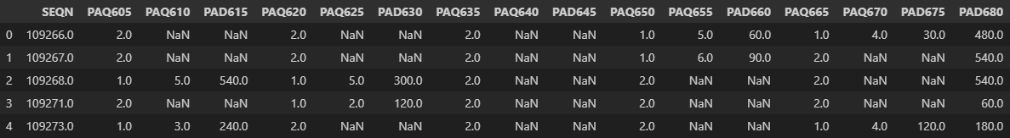
Data Wrangling & Merging
Data exploration for each dataset, then merged them together based on the SEQN
Utilized a left-merge to prevent data loss
In all of the datasets, both variable names and values were numerically coded
Renamed all the variables
Trimmed down dataset several times, resulting in a final dataset with 15 columns and 15560 rows
Notes:
Once I had the 4 dataframes in jupyter notebook, I looked over each of them to check for missing values and variable types. It was clear that the number of observations in each dataset varied widely, ranging from 9,000 rows to over 32,000 rows.
The SEQN column referred to the respondent IDs, and they aligned across datasets so I merged the datasets based on that column. I used a left merge to prevent data loss, even though it would result in some columns having many NAs.
Upon merging, the dataset had 67 columns and 32962 rows. I then renamed all of the coded column names using the documentation found on the CDC/NHANES website.
Finally, we trimmed down the dataset a couple times, prioritizing the variables we were especially interested in. We ended up with a final dataset with 15 columns and 15560 rows and exported it to CSV.
We each chose some variables that we wanted to focus on, and we would individually pull from this CSV file when doing our separate analyses. Each of us had more data cleaning to do on our allotted variables, mainly recoding variable values and dealing with other issues.

Slide 7

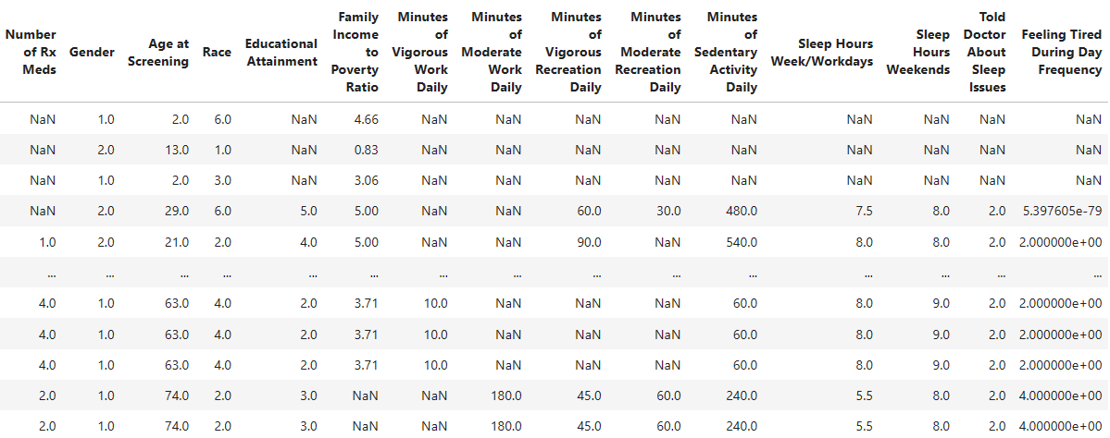
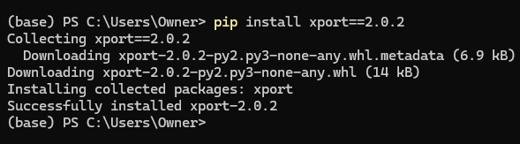
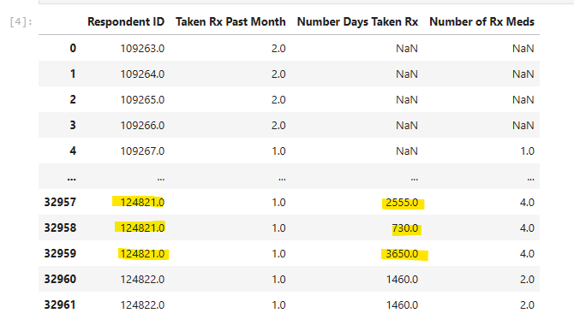
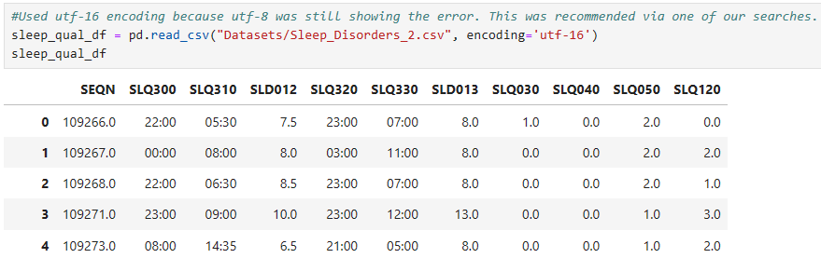
Overview
continued…
Debugging the data
Isolate and clean sleep data
Install xport
Utf-16 encoding
Respondent ID = unique
Divided variables (columns) up amongst the team to explore data for patterns, correlations, etc.
Notes:
Doing some data checking.
Noticed one of the sleep data columns wasn’t pulling in the correct formatting. Tried searching, troubleshooting and was likely an issue with the xpt file.
Had wondered about encoding early on also column formatting etc.
Jordan provided some resources on xpt. Caleb had success with pd.read_sas function - 905% of the data looked good. I decided to try the xport module. Wasn’t able to get xport has an issue in pandas currently so imported outside of pandas via pip install and then converted sleep data only to csv outside of pandas. Then read in the csv using a new encoding key utf-16 (this was the issue!) and we later merged it with the rest of the data.
Also in making sure our data was adding up, I was comparing our total numbers for each column to what was published in a summary on the website. Some were adding up many weren’t. Respondent ID (SEQN) is unique identifier for all but rx data in which a respondent if they indicate “yes” takes prescription meds, will then be asked how many days did they take each med so you generate duplicate rows per respondent. Evaluated options. Easiest way forward was to eliminate duplicate Respondent IDs b/c the data we would be eliminating isn’t data we wanted to analyze - other data would not be affected. As we were working sequentially, this was done on data that had been cleaned up by Melissa and that became our new working data set.

Slide 8
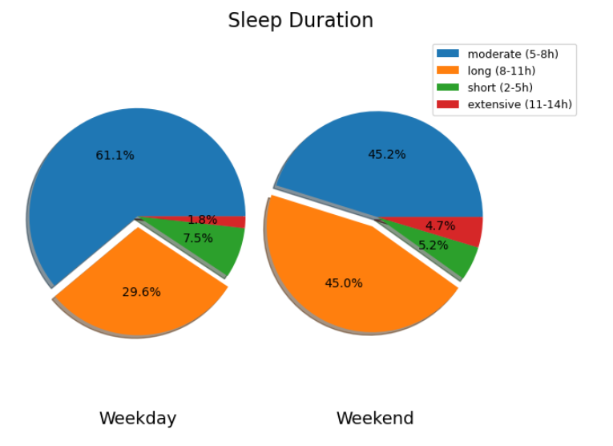
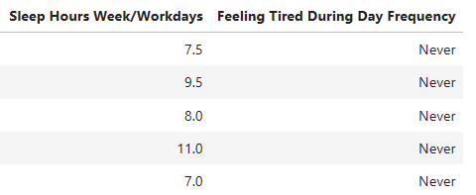
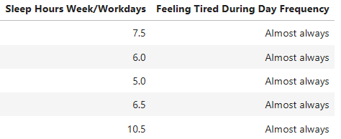
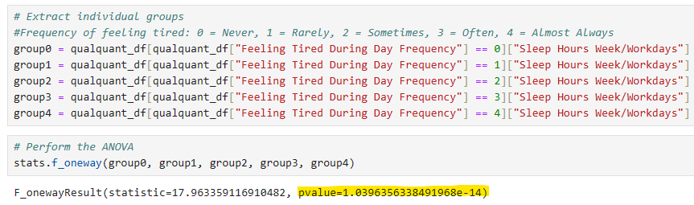
Total Sleep Duration and Quality
Rarely
Sometimes
Often
Majority: 5-8hrs (moderate) during the week
Largest difference (8-11hrs): 29.6% → 45.2%
(weekday vs weekend)
% of respondents who get 2-5hrs sleep is higher during the week
Notes:
Start off the sleep data. Numerical and categorical.
Used plt.subplot to create axis/grid so pie charts could be visualized side-by-side
Compared sleep patterns weekdays vs weekends.
Observationally, looks like based on almost always individuals having low numbers there could be a correlation.
Performed ANOVA
If I did it correctly, there is a correlation between number of hours slept during the week and feeling tired. (makes sense)

Slide 9
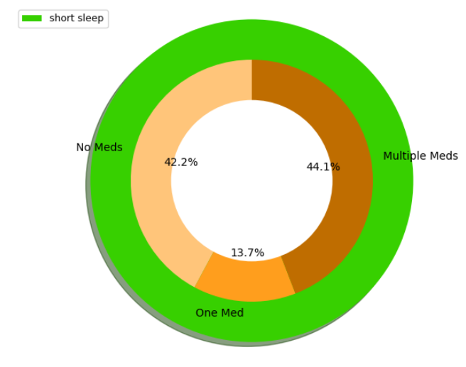
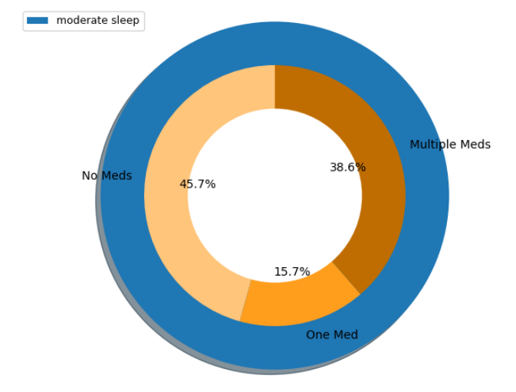
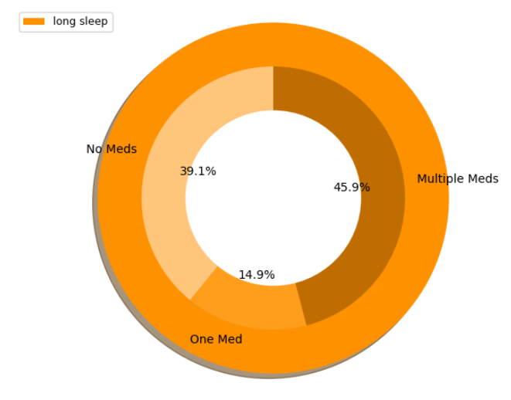
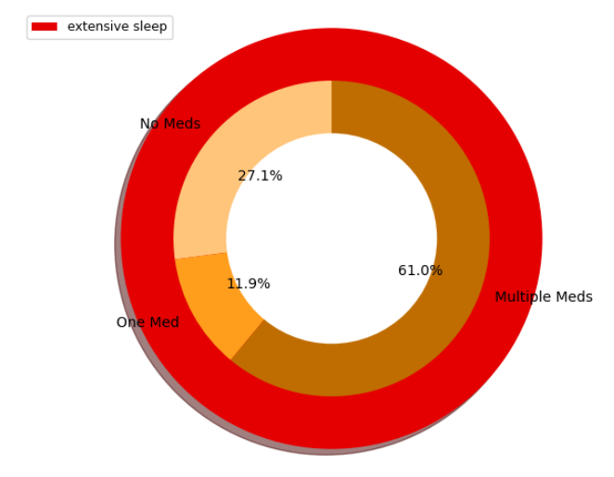
Prescription Medication and Sleep
The proportion of individuals taking multiple medications is highest (61%) in the extensive sleepers group (11-14 hrs/night)
Performed chi square: → the distribution of medication use among extensive sleepers compared to other groups is NOT statistically significant
Stat: 0.137, p-val: 0.93
Critical value: 5.99
Notes:
First variable we looked at was prescription medication use.
Distribution of medication use is similar among the other 3 groups so used the average as “expected” and the values in the extensive group as the observed to determine if statistically significant difference between the two (NOT).
Much smaller sample size (n=177) compared with other groups.

Slide 10
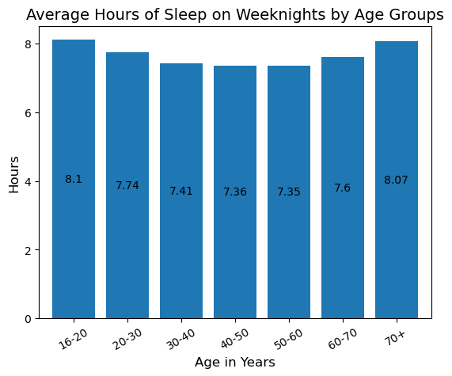
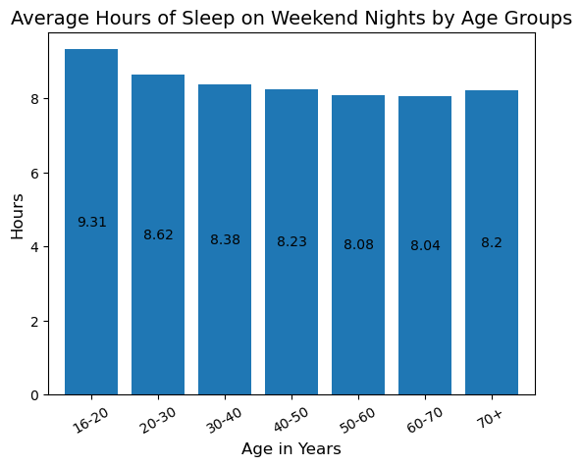
Sleep Duration Across Age Groups
F = 51.62, p-value = 6.57e⁻⁶³
F = 74.27, p-value = 4.66e⁻⁹¹
Notes:
I began my analysis by focusing on reported activity levels and measures of sleep quality, but it became clear that the categorical nature of these variables made numerical analysis extremely difficult. This should not have been a surprise given that these variables were qualitative survey data, but it was still a bummer.
I switched my focus and looked at the respondents’ ages as a predictor of sleep duration, on both weeknights and weekend nights. I binned the dataframe by age, making 7 age groups, and then calculated the mean sleep duration of the respondents for each bin.
As you can see, during the week, it appears that younger respondents had more sleep, followed by a decline as respondents entered the middle age, and then a rebound in older age.
This made me wonder if this pattern is due to work related factors, as sleep is higher in pre-career and post-retirement age groups.
As for the weekend nights, the younger age groups also have the most sleep on average, followed by a steady decline and then a slight rebound in the oldest respondents.
To check whether these group mean differences were significant, I performed two one-way ANOVAs--one for weeknights and and one for weekend nights, and they both suggested that there was a significant difference in average sleep hours between the age groups (as indicated by the tiny p-values and fairly large F values)
While I wanted to make conclusions about these sleep patterns, it wasn’t really possible due to the fact that this data did not come from a longitudinal study. It would be cool to see if this trend would remain the same in a time series analysis.

Slide 11
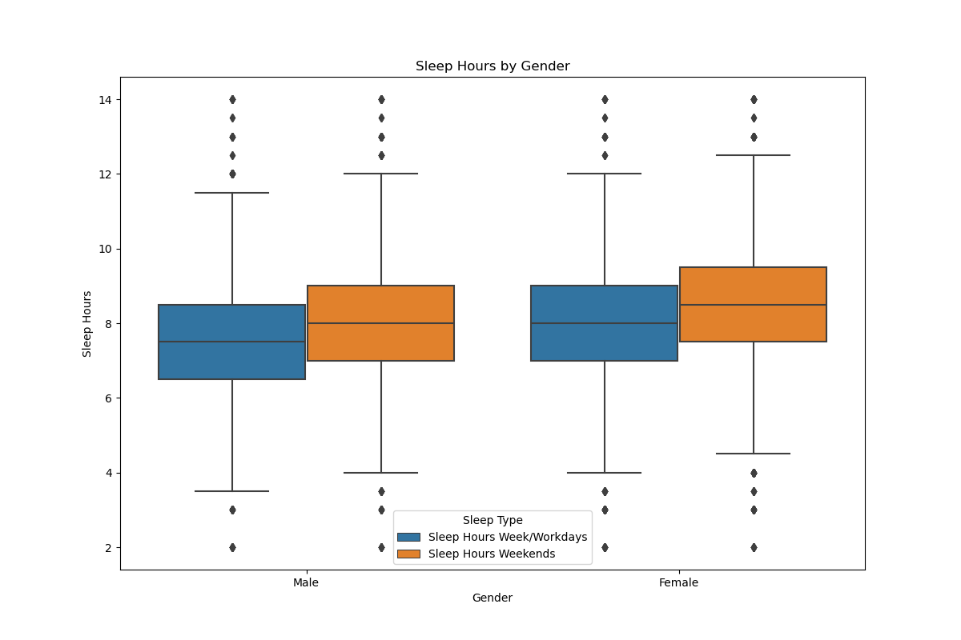
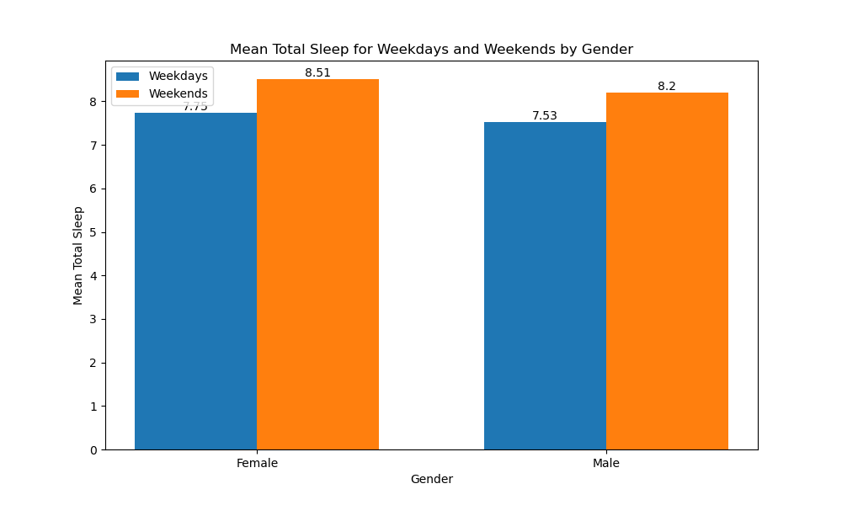
Gender and sleep
In looking at Gender as expected both Males and Females slept less on weekdays. than weekends, with females sleeping more than Males. Again with no significant statistical variation.
Notes:
Jim

Slide 12
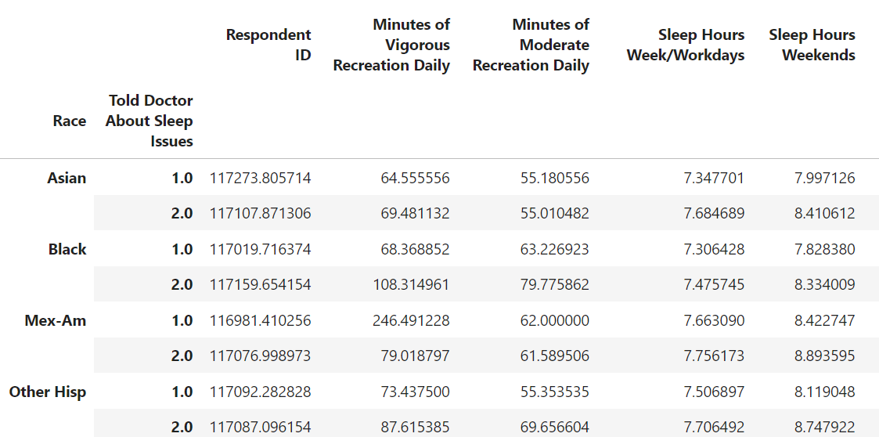
Code to Group Items in a Useful DataFrame
full_group1 = Race_update[Race_update["Told Doctor About Sleep Issues"].apply(lambda x: x in [1.0, 2.0])].groupby(["Race", "Told Doctor About Sleep Issues"]).mean()
full_group1
Comparison:
By grouping respondents by race, I could see if there were strong connections between them speaking with a doctor (1.0) or not (2.0).

Slide 13
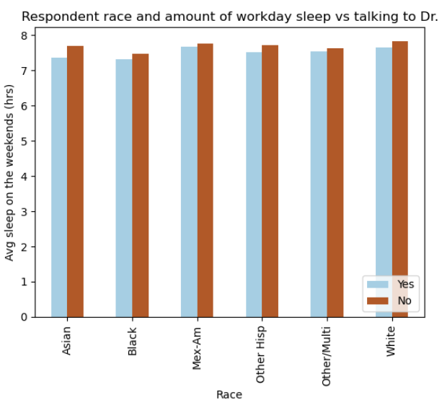
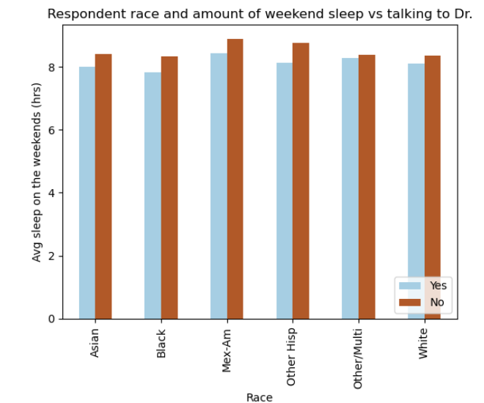
Race and Sleep:
Every race was slightly less likely to talk to a doctor about sleep, no matter how long they slept throughout the week

Slide 14
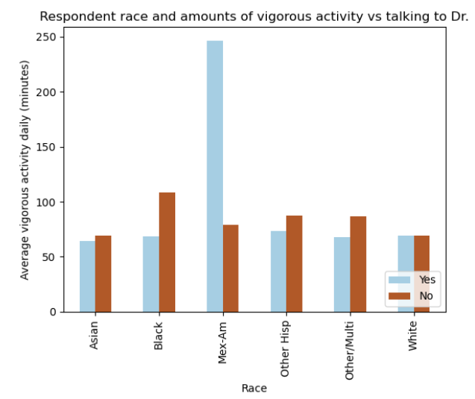
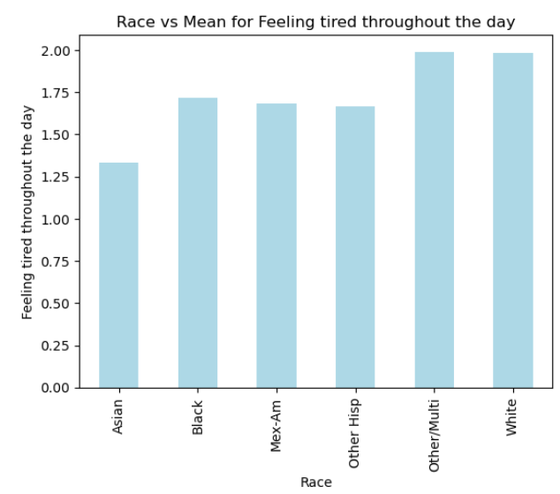
Race and Sleep:
Highly active Mexican-Americans are a lot more likely to talk about sleep with their doctor.
Asians are the least likely to say they feel tired throughout the day according the mean score of the different races.

Slide 15
Conclusions
Brittany: A statistically significant correlation was found between duration of weekday sleep time and frequency of feeling “tired”. There was a non-significant but noticeable difference in distribution of prescription medication use between the respondents reporting 11-14 hrs of sleep vs all other sleep groups.
Caleb: We observed statistically significant differences in average sleep duration between at least two of the age 7 groups. This was true for both weeknights and weekend nights.
Jim: In looking at income levels vs. gender there were no significant findings, as the data provided was grouped as percentage of poverty level and only had incomes lease than $20K and above $20K, . In looking at Gender as expected both Males and Females slept less on weekdays. than weekends, with females sleeping more than Males. Again with no significant statistical variation.
Melissa: Generally, no race was more likely to discuss sleep with their doctor than not. Most respondents were close in their “feeling tired during the day,” self-evaluation, too.

Slide 16
Potential Next Steps for the Project
In the future, it could be helpful to start combining these factors and look at the difference, for example, between active, middle-aged Asian respondents compared to active, middle-aged Mexican-American respondents. Combining factors would create a more holistic view of the data and pinpoint the specific variables that impact sleep behavior and quality.
In addition, performing more exploratory and complex analysis on variables in which statistically significant findings were achieved by the primary analysis could yield interesting results.

